Slide 1
Computer Organization & Architecture

Slide 2
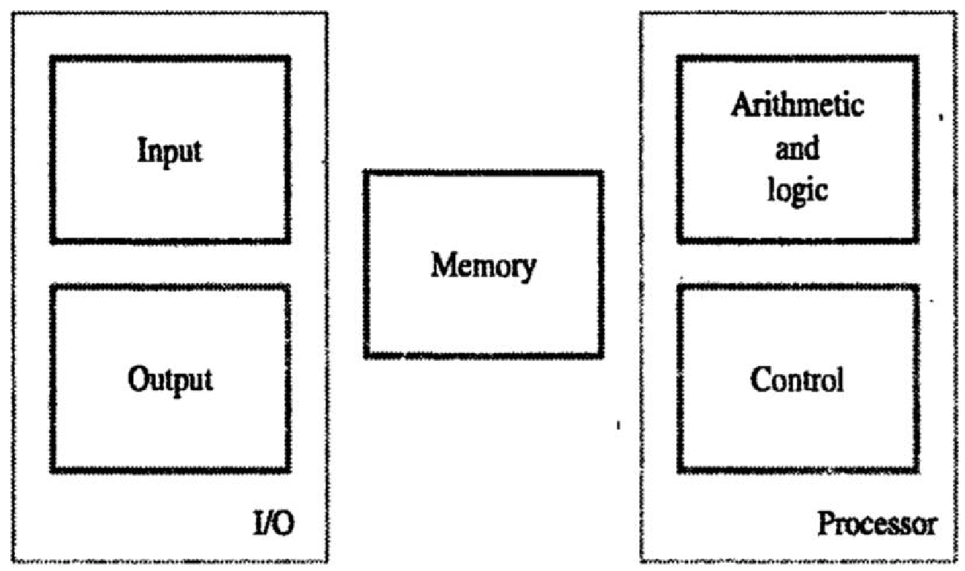
FUNCTIONAL UNITS:
The computer system is divided into five separate units for its operation.
Input Unit.
Memory Unit.
ALU.
Control Unit.
Output Unit.
The input unit accepts the code information from the users .The information received is either stored in the Memory or immediately used by the Arithmetic & Logic circuitry to form the desired operations .The processing steps are determined by the program stored in the memory. Finally the results are sent back to the outside world through the output unit. All these actions are coordinated by the control unit

Slide 3
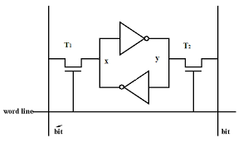
Input Unit.
Input units are used by the computer to read the data. The most commonly used input devices are keyboards, mouse, joysticks, trackballs, microphones, etc..
Most well known input device is the keyboard. Whenever a key is pressed, the corresponding letter or digit is automatically translated in to its binary code and transmitted through a cable either to memory or the processor
Memory Unit.
The function of the memory unit is to store programs and data.
There are two classes of storage, called primary and secondary.
Programs must be stored in memory while they are being executed.
Memory contains a large number of semiconductor storage cells, each capable of storing one bit of information.
These cells are rarely read or written as individual cell but instead are processed in groups of fixed size called word.
The memory is organized so that the contents of one word containing n bits can be stored and retrieved in one basic operation
To provide easy access to any word in memory, a distinct address is associated with each word location. Address are numbers that identify successive locations. A given is accessed by its address and issuing a control command that starts the storage or retrieval process

Slide 4
Arithmetic and logic unit
Most of all the arithmetic and logical operations of a computer are executed in the ALU (Arithmetic and Logical Unit) of the processor. It performs arithmetic operations like addition, subtraction, multiplication, division and also the logical operations like AND, OR, NOT operations.
Output Unit.
The primary function of the output unit is to send the processed results to the user. Output devices display information in a way that the user can understand.
Output devices are pieces of equipment that are used to generate information or any other response processed by the computer. These devices display information that has been held or generated within a computer.
The most common example of an output device is a monitor.
Control Unit.
Control unit controls and coordinates the entire operations of the computer system.
The control unit determines the sequence in which computer programs and instructions are executed.
Things like processing of programs stored in the main memory, interpretation of the instructions and issuing of signals for other units of the computer to execute them

Slide 5
The operation of a computer can be summarized as follows
The computer accepts information in the form of programs and data through an input and stores it in the memory
Information stored in the memory is fetched to the processor where it is processed
Processed information leaves the computer through an output unit
All activities inside the machine are directed by control unit

Slide 6
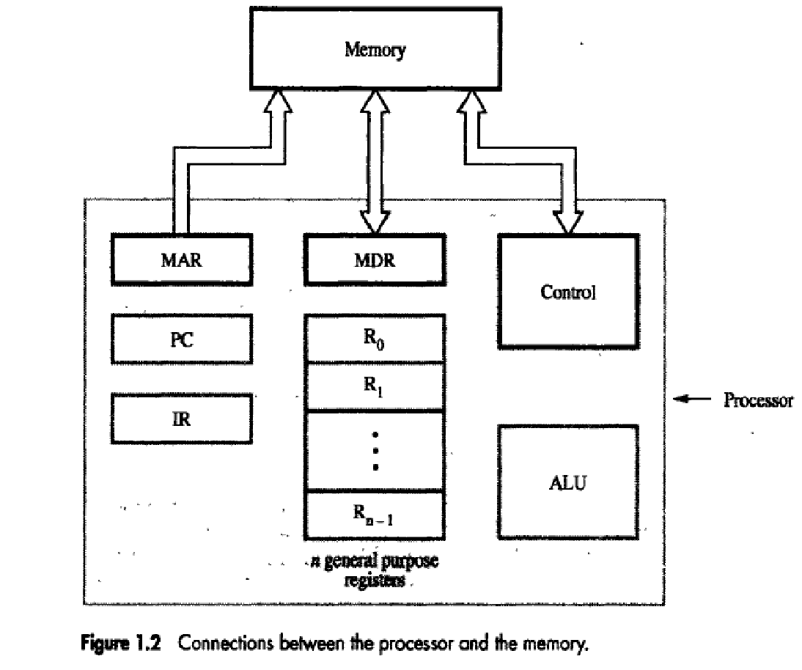
BASIC OPERATIONAL CONCEPTS
To perform a given task, an appropriate program consisting of a list of instructions is stored in the memory
Individual instructions are brought from memory into processor, which executes the specific operations
Data to be used as operands are also stored in memory
Load LOC,R2 :The operand at LOC is fetched from the memory into the register R2
Add R1, R2, R3 :Adds the contents of registers R1 and R2, then places their sum into register R3.
Store R4, LOC :This instruction copies the operand in register R4 to memory location
Add R1, R0 :Add contents of R1, R0 and place the sum to R0.

Slide 7
The figure 1.2 shows how the memory and the processor can be connected. In addition to the ALU and the control circuitry, the processor contains a number of registers used for several different purposes
The instruction register (IR) holds the instruction that is currently being executed.
The program counter (PC) contains the memory address of the next instruction to be fetched and executed.
In addition to the IR and PC, general-purpose registers R0 through Rn−1, often called processor registers. They serve a variety of functions, including holding operands that have been loaded from the memory for processing.
Finally, two registers facilitate communication with the memory. These are the Memory Address Register (MAR)and the Memory Data Register(MDR)
MAR holds the address of the location to be accessed.
MDR contains the data to be written into or read out of the addressed location

Slide 8
Operating Steps
The contents of PC are transferred to MAR. A read signal is sent to the memory.
The first instruction is read out and loaded into MDR.
The contents of MDR are transferred to IR.
Decode and execute the instruction
During the execution, PC is incremented to the next instruction.

Slide 9
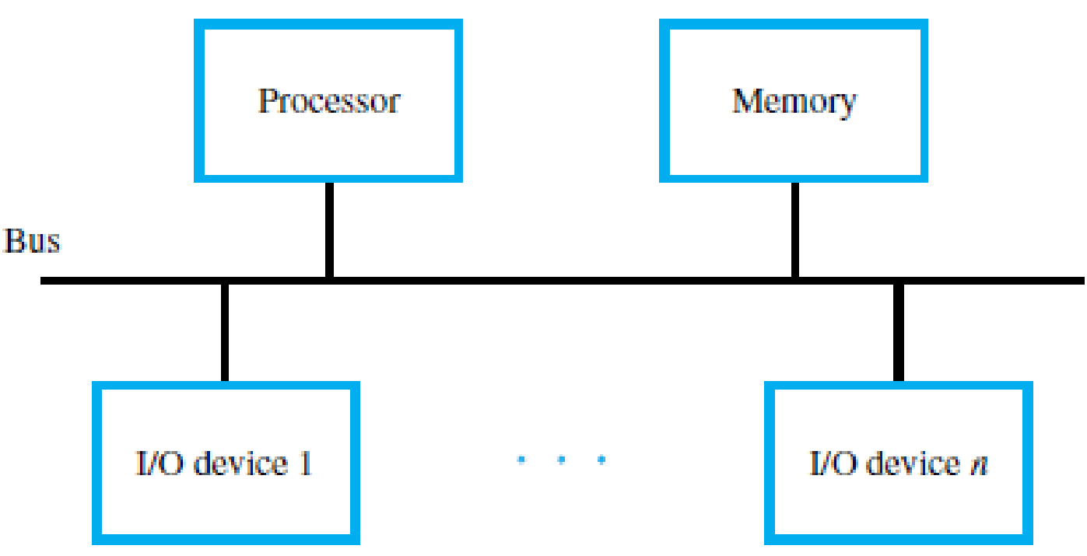
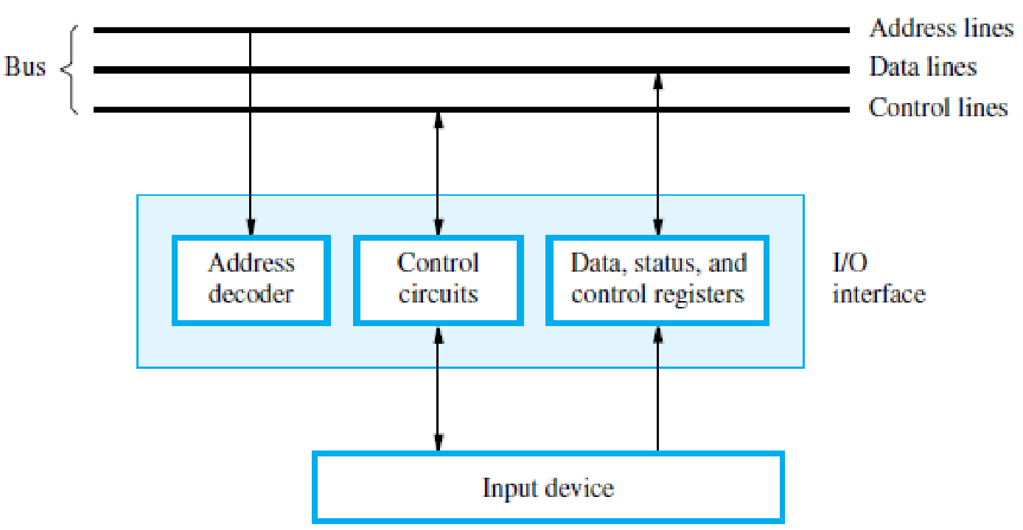
BUS STRUCTURES
A group of lines that serves as a connecting path for several devices is called a bus
The simplest way to interconnect functional units is to use a single bus (All the units are connected to this bus)
Only two units can actively use the bus at any given time
System that contain multiple bus allows two or more transfers to be carried out at the same time
When a word of data is transferred between units, all its bits are transferred in parallel ie the bits are transferred simultaneously over many wires or lines, one bit per line

Slide 10
MEMORY LOCATIONS AND ADDRESSES
The memory consists of many millions of storage cells, each of which can store a bit of information having the value 0 or 1.
The memory is organized so that a group of n bits can be stored or retrieved in a single, basic operation.
Each group of n bits is referred to as a word of information, and n is called the word length
A unit of 8 bits is called a byte.
Machine instructions may require one or more words for their representation.
Accessing the memory to store or retrieve a single item of information, either a word or a byte, requires distinct names or addresses for each location.
The memory can have up to 2^{k} addressable locations. The 2^{k} addresses constitute the address space of the computer

Slide 11
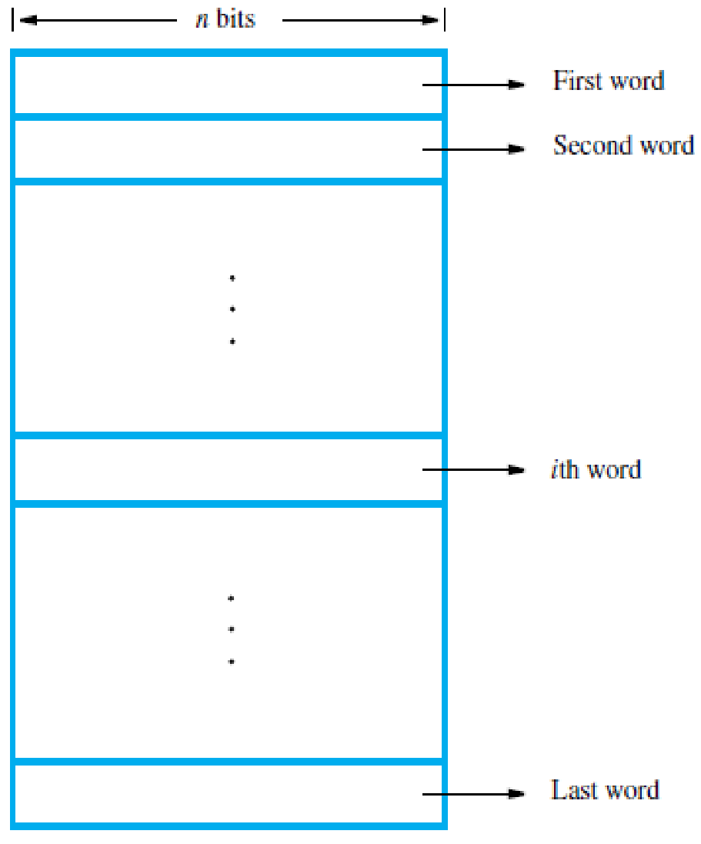
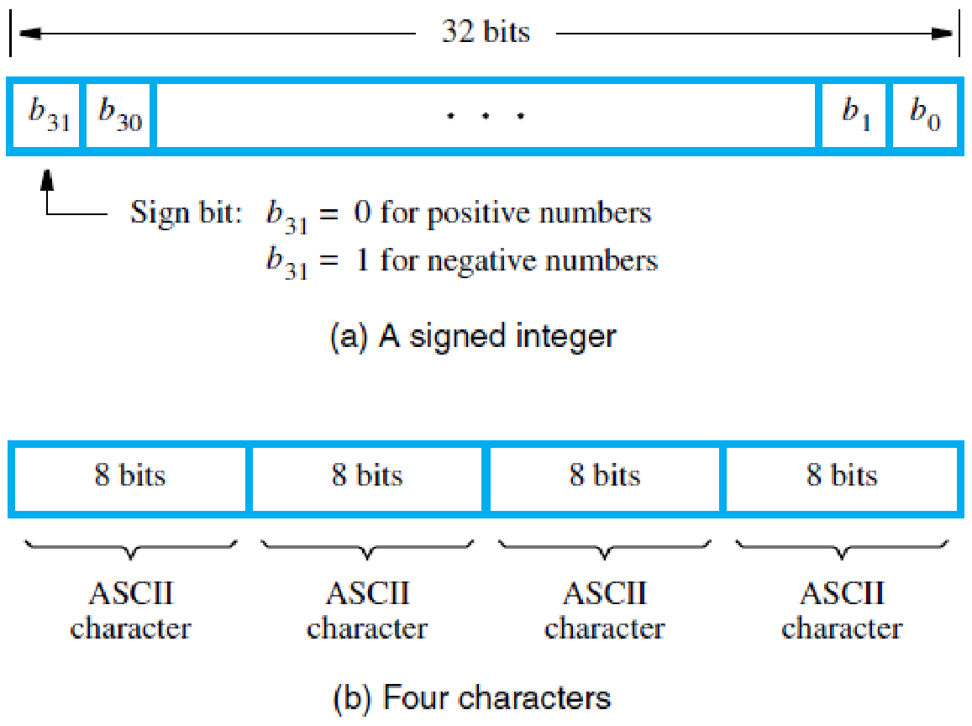
Byte Addressability
We now have three basic information quantities to deal with: bit, byte, and word.
A byte is always 8 bits, but the word length typically ranges from 16 to 64 bits.
It is impractical to assign distinct addresses to individual bit locations in the memory. The most practical assignment is to have successive addresses refer to successive byte locations in the memory.
The term byte-addressable memory is used for this assignment. Byte locations have addresses 0, 1, 2 . . . Thus, if the word length of the machine is 32 bits, successive words are located at addresses 0, 4, 8… with each word consisting of four bytes.

Slide 12
Word Alignment
In the case of a 32-bit word length, natural word boundaries occur at addresses 0, 4, 8…
We say that the word locations have aligned addresses if they begin at a byte address that is a multiple of the number of bytes in a word.
For practical reasons associated with manipulating binary-coded addresses, the number of bytes in a word is a power of 2.
Hence, if the word length is 16 (2 bytes), aligned words begin at byte addresses 0, 2, 4... and for a word length of 64 (8 bytes), aligned words begin at byte addresses 0, 8, 16…

Slide 13
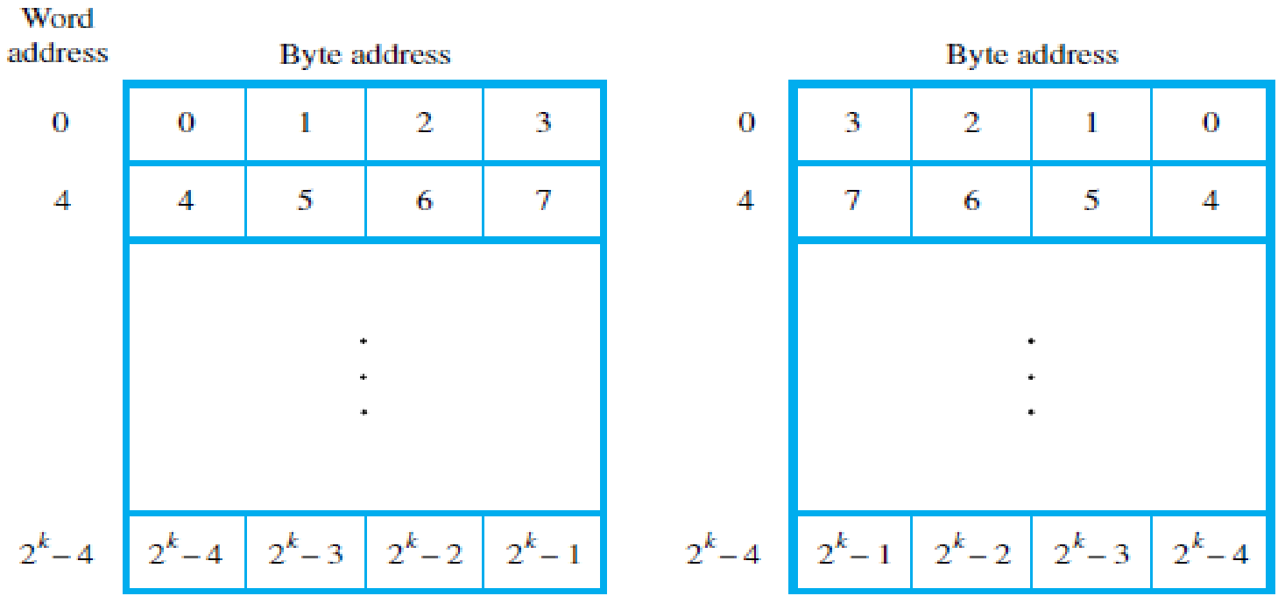
Big-Endian and Little-Endian Assignments
There are two ways that byte addresses can be assigned across words.
The name big-endian is used when lower byte addresses are used for the more significant bytes (the leftmost bytes) of the word.
The name little-endian is used for the opposite ordering, where the lower byte addresses are used for the less significant bytes (the rightmost bytes) of the word.

Slide 14
MEMORY OPERATIONS
Both program instructions and data operands are stored in the memory.
Two basic operations involving the memory are needed, namely, Load (or Fetch or Read) and Store (or Write).
The Read operation transfers a copy of the contents of a specific memory location to the processor. The memory contents remain unchanged.
To start a Read operation, the processor sends the address of the desired location to the memory and requests that its contents be read.
The memory reads the data stored at that address and sends them to the processor
The Write operation transfers an item of information from the processor to a specific memory location, overwriting the former contents of that location.
To initiate a Write operation, the processor sends the address of the desired location to the memory, together with the data to be written into that location.
The memory then uses the address and data to perform the write.

Slide 15
INSTRUCTIONS AND INSTRUCTION SEQUENCING
A computer must have instructions capable of performing four types of operations:
1. Data transfers between the main memory and the CPU registers
2. Arithmetic and logic operations on data
3. Program sequencing and control
4. I/O transfers

Slide 16
Notations used:-
a) Register Transfer Notation (RTN):- Possible locations involved in transfer of information are memory location, CPU registers or registers in the I/O subsystem.
We identify the names for the addresses of memory location as LOC, PLACE, A, VAR2 etc and the names for CPU registers as R0, R5 etc.
The contents of a location or a register are denoted by placing the corresponding name between square brackets.

Slide 17
E.g. i) R1 ← [LOC] means that the contents of memory location LOC are transferred into register R1.
ii) R3 ← [R1] + [R2] adds the contents of registers R1 and R2 and then places their sum into register R3.
b) Assembly Language Notation:- The same operations can be represented in assembly language format as shown below.
E.g. i) Move LOC, R1
ii) Add R1,R2,R3

Slide 18
BASIC INSTRUCTION TYPES
There are five types of instruction formats in a computer that are commonly used, namely:
1. Three-address instruction format
2. Two-address instruction format
3. One-address instruction format
4. Zero-address instruction format
5. One-and-half address instruction format

Slide 19
Three-address instruction
C = A + B is a high level instruction to add the values of the two variables A and B and to assign the sum to a third variable C.
When this statement is compiled, each of these variables is assigned to a location in the memory.
The contents of these locations represent the values of the three variables. Hence the above instruction requires the
Action: C ← [A] + [B]
To carry out this instruction, the contents of the memory locations A and B are fetched from the main memory and transferred into the processor – sum is computed – result is sent back to memory and stored in location C.
The same action is performed by a single machine instruction (three address instruction)
Add A,B,C
Operands A and B are called the source operands, C is called the destination operand, and Add is the operation to be performed on the operands.
The general format is Operation Source1,Source2, Destination

Slide 20
Two-address instruction
An alternative method is to use two address instruction of the form
Operation Source, Destination
E.g. Add A,B which perform the operation
B ←[A] + [B]
Here the sum is calculated and the result is stored in location B replacing the original contents of this location. i.e. operand B acts as source as well as destination.
In the former case (three address instruction) the contents of A and B were not destroyed.
But here the contents of B are destroyed. This problem is solved by using another two-address instruction to copy the contents of one memory location into another location.
C ←[A] + [B] is equivalent to
Move B,C
Add A,C

Slide 21
One-address instruction
Instead of mentioning the second operand, it is understood to be in a unique location.
A processor register usually called the Accumulator is used for this purpose.
E.g. i) Add A means that the contents of the memory location A is added to the contents of accumulator and places the sum in the accumulator.
ii) Load A copies the contents of memory location A into accumulator
iii) Store A copies the contents of accumulator to the location A
Depending on the instruction, the operand may be source or destination.
Now the operation C ←[A] + [B] can be performed by executing the following instructions
Load A
Add B
Store C

Slide 22
When a processor has several general-purpose registers, then many instructions involve only operands that are in registers
E.g., Add Ri, Rj
Add Ri, Rj, Rk
In the first instruction, Rj acts as both source and destination. In the second instruction, Ri And Rj are source and Rk is the destination
Advantages of using CPU registers:
i) Data access from these registers is faster than that of main memory locations; because these registers are inside the processor.
ii) Only few bits are needed to specify the register; because the number of registers is very less.
For example, only 5 bits are needed to specify 32 registers.
iii) Instructions, where only register names are contained, will normally fit into one word of memory

Slide 23
Zero-address instruction
Here locations of all operands are defined implicitly. Such instructions are found in machines that store operands in a structure called a pushdown stack.
A stack is a list of data elements, usually words or bytes, in which these elements can be added or removed through the top of the stack by following the LIFO (last-in-first-out) storage mechanism.
A processor register called stack pointer. (SP) is used to keep track of the address of the element at the top of the stack at any given time.
The terms push and pop are used to describe placing a new item on the stack and removing the top item from the stack respectively.

Slide 24
One and half-address instruction
An instruction that specifies one operand in memory and one operand in a CPU register is referred to as one-and-half address instruction.
Using registers it is possible to increase the speed of processing

Slide 25
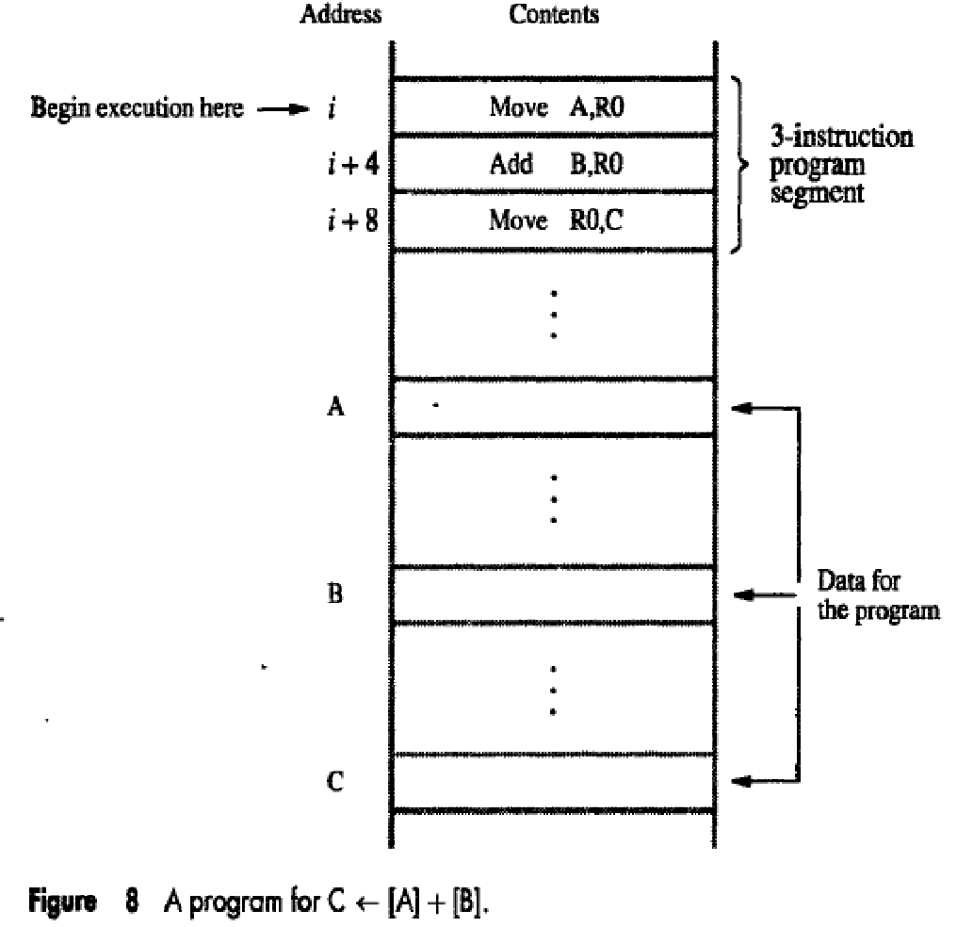
Instruction Execution and Straight-Line Sequencing
Let’s consider task C = A + B, implemented as
C←[A] + [B].
Figure shows a possible program segment for this task as it appears in the memory of a computer.
We assume that the word length is 32 bits and the memory is byte-addressable.
The three instructions of the program are in successive word locations, starting at location i. Since each instruction is 4 bytes long, the second and third instructions are at addresses i + 4 and i + 8.

Slide 26
Let us consider how this program is executed.
To begin executing a program, the address of its first instruction (i in our example) must be placed into the PC.
Then, the processor control circuits use the information in the PC to fetch and execute instructions, one at a time, in the order of increasing addresses. This is called straight-line sequencing.
During the execution of each instruction, the PC is incremented by 4 to point to the next instruction. Thus, after the Move instruction at location i + 8 is executed, the PC contains the value i + 12
Executing a given instruction is a two-phase procedure.
In the first phase, called instruction fetch, the instruction is fetched from the memory location whose address is in the PC. This instruction is placed in the instruction register (IR) in the processor.
At the start of the second phase, called instruction decode & execute, the instruction in IR is examined to determine which operation is to be performed.
The specified operation is then performed by the processor.

Slide 27
As each instruction is executed, the PC is incremented by 4 to point to the next instruction.
Executing a given instruction is a two-phase procedure
First Phase - Instruction Fetch: Instruction is fetched from the main memory location whose address is in the PC and is placed in the Instruction Register (IR)

Slide 28
Second Phase – Instruction Execute: Instruction in the IR is examined to determine which operation is to be performed.
The specified operation is performed by the processor.
This may involve fetching operands from main memory (or processor
registers), performing an arithmetic or logic operation and storing the result in the destination location.
At some point during this two-phase procedure, the contents of the PC are advanced to point to the next instruction.
After the execution phase is over, new instruction fetch can begin.

Slide 29
Branching
This type of instruction loads a new address into the program counter.
As a result, the processor fetches and executes the instruction at this new address, called the branch target, instead of the instruction at the location that follows the branch instruction in sequential address order.
A conditional branch instruction causes a branch only if a specified condition is satisfied.
If the condition is not satisfied, the PC is incremented in the normal way, and the next instruction in sequential address order is fetched and executed.

Slide 30
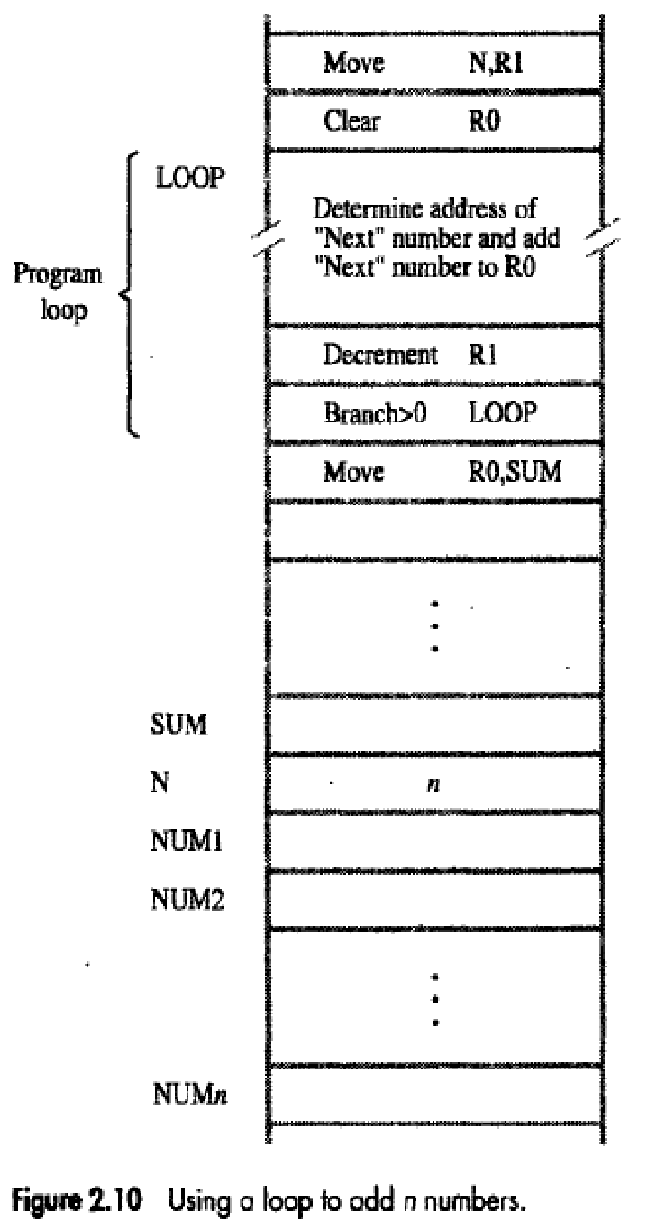
Consider the task of adding a list of n numbers.
LOOP is a straight line sequence of instructions executed as many times as needed.
Assume that the number of entries in the list, n, is stored in memory location N.
Register R1 is used as a counter to determine the number of times the loop is executed.
Hence, the contents of location N are loaded into register R1 at the beginning of the program.
Then, within the body of the loop, the instruction Decrement R1 reduces the contents of R1 by 1 each time through the loop.
Execution of the loop is repeated as long as the content of R1 is greater than zero.

Slide 31
Branch>0 LOOP is same is a conditional branch instruction that causes a branch to location LOOP if the contents of register R1 are greater than zero.
This means that the loop is executed as long as there are entries in the list that are yet to be added to R0.
At the end of the nth pass through the loop, the Decrement instruction produces a zero and hence branching does not occur.
Move instruction is fetched and executed. It moves the final result from R0 into memory location SUM.

Slide 32
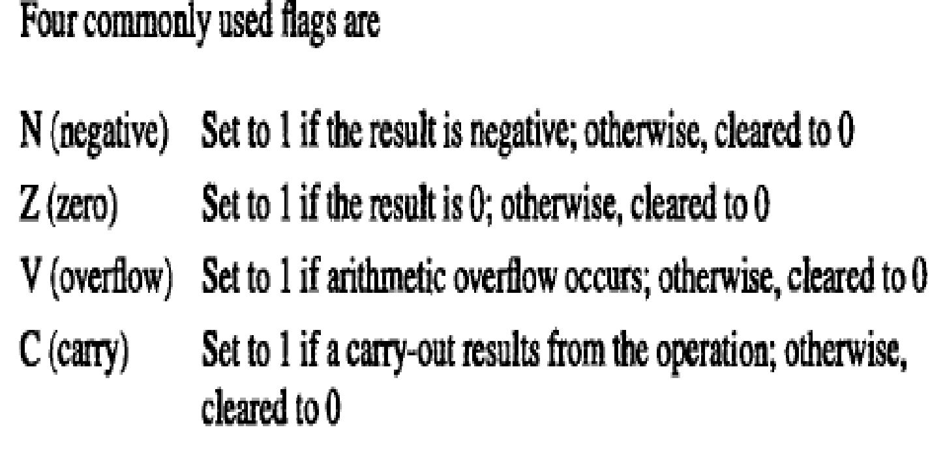
Condition Codes
The processor keeps track of instruction about the results of various operations for use by subsequent conditional branch instructions.
This is accomplished by recording the required information in individual bits often called as conditional code flags.
These flags are usually grouped together in a special processor register called the condition code register or status register.
Individual condition codes are set to 1 or cleared to 0, depending upon the outcome of the operation performed.

Slide 33
ADDRESSING MODES
The different ways for specifying the locations of operands are known as addressing modes.
Immediate mode:
The operand is given explicitly in the instruction.
Example: The instruction Add #200, R1, R2 adds the value 200 to the contents of register R1, and places the result into register R2.
A common convention is to use the number sign (#) in front of the value to indicate that this value is to be used as an immediate operand.
Register mode:
The operand is the contents of a processor register; the name (address) of the register is given in the instruction.
Example: The instruction Add R1, R2, R3 uses the Register mode for all three operands.
Registers R1 and R2 hold the two source operands, while R3 is the destination.

Slide 34
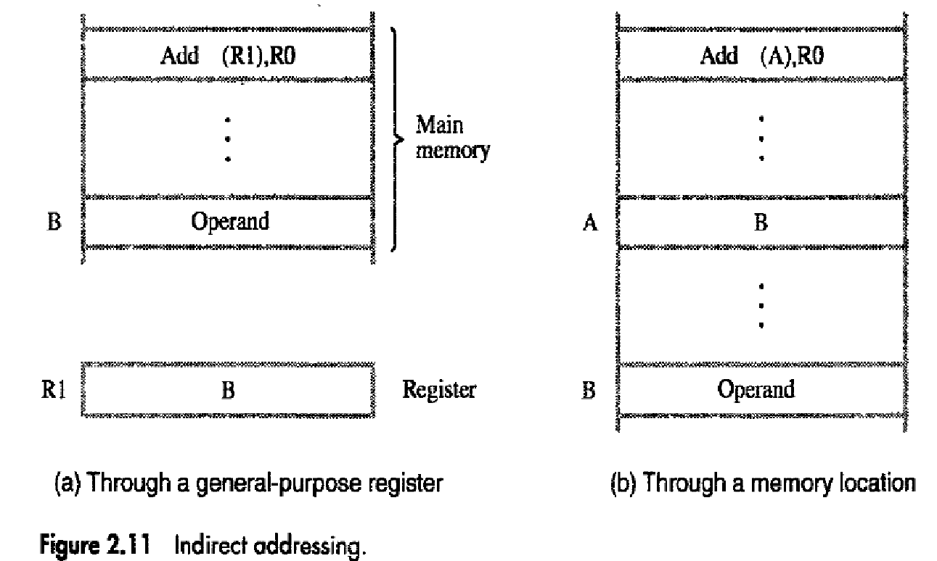
Absolute/Direct mode:
The operand is in a memory location; the address of this location is given explicitly in the instruction.
Example: The Absolute mode is used in the instruction Move LOC, R1 which copies the value in the memory location LOC into register R1.
Indirect mode:
The effective address of the operand is the contents of a register or memory location whose address appears in the instruction. We denote indirection by placing the name of the register given in the instruction in parentheses ().

Slide 35
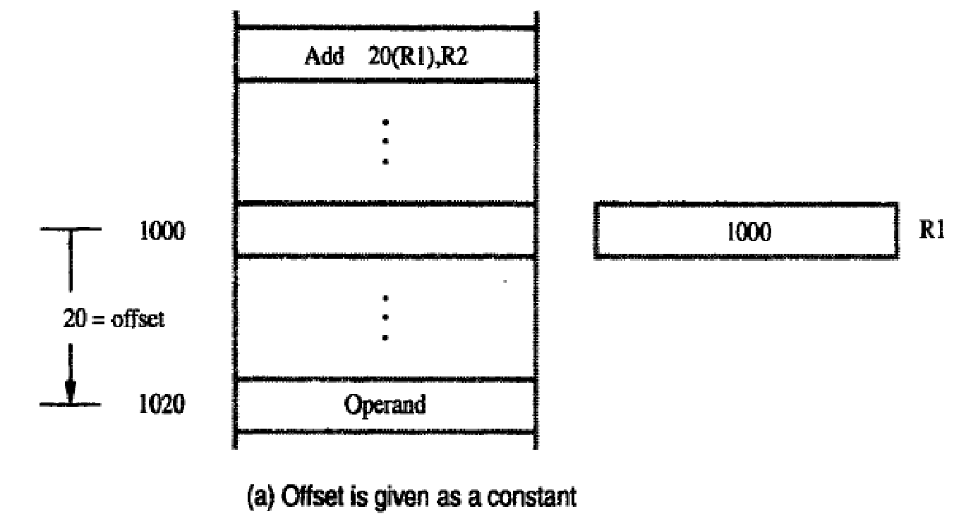
Index mode:
The effective address of the operand is generated by adding a constant value to the contents of a register.
The register used in this mode is referred as the index register.
We indicate the Index mode symbolically as X(Ri) where X denotes a constant signed integer value contained in the instruction and Ri is the name of the register involved.
The effective address of the operand is given by EA = X + [Ri].
The contents of index register are not
changed in the process of generating
the effective address.

Slide 36
Base with index:
A second register may be used to contain the offset X, in which case the index mode is written as, (Ri,Rj).
The effective address is the sum of the contents of register Ri and Rj.
The second register is called as base register.
Base with index and offset:
Uses two registers plus a constant denoted as X(Ri,Rj).
The effective address is the sum of the constant X and the contents of register Ri and Rj.
Relative Addressing
In index addressing, if the program counter PC, is used instead of a general-purpose register then X(PC) can be used to address a memory location that is X bytes away from the location presently pointed to by the program counter.
Since the addressed location is identified "relative" to the program counter, which always identifies the current execution point in a program, the name Relative mode is associated with this type of addressing.

Slide 37
Auto-increment mode:
The effective address of the operand is the contents of a register specified in the instruction.
After accessing the operand, the contents of this register are automatically incremented to point to the next item in a list.
We denote the Auto-increment mode by putting the specified register in parentheses, to show that the contents of the register are used as the effective address, followed by a plus sign to indicate that these contents are to be incremented after the operand is accessed.
Thus, the Auto-increment mode is written as (Ri)+
Auto-decrement mode:
The contents of a register specified in the instruction are first automatically decremented and are then used as the effective address of the operand.
The Auto-increment mode is written as -(Ri)

Slide 38
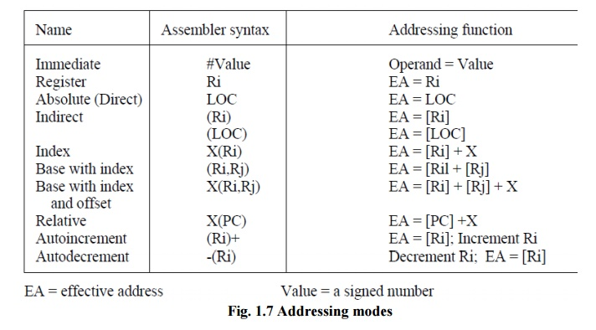

Slide 39
BASIC PROCESSING UNIT - SOME FUNDAMENTAL CONCEPT
To execute a program, the processor fetches one instruction at a time and performs the operations specified.
Instructions are fetched from successive memory locations until a branch or a jump instruction is encountered.
The processor keeps track of the address of the memory location containing the next instruction to be fetched using the program counter, PC.
After fetching an instruction, the contents of the PC are updated to point to the next instruction in the sequence.
A branch instruction may load a different value into the PC. Another key register in the processor is the instruction register, IR

Slide 40
BASIC PROCESSING UNIT - SOME FUNDAMENTAL CONCEPT
Suppose that each instruction comprises 4 bytes, and that it is stored in one memory word. To execute an instruction, the processor has to perform the following three steps:
Fetch the contents of the memory location pointed to by the PC. The contents of this location are the instruction to be executed; hence they are loaded into the IR. In register transfer notation, the required action is IR←[[PC]]
Increment the PC to point to the next instruction. Assuming that the memory is byte addressable, the PC is incremented by 4; that is PC←[PC] + 4
Carry out the operation specified by the instruction in the IR.
Fetching an instruction and loading it into the IR is usually referred to as the instruction fetch phase.
Performing the operation specified in the instruction constitutes the instruction execution phase.

Slide 41
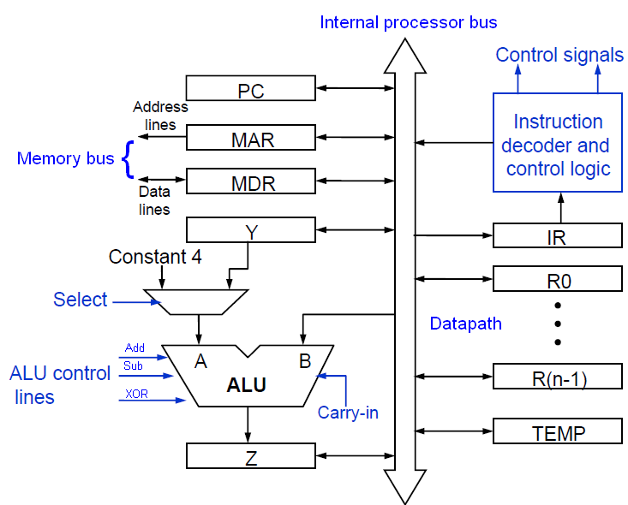
Internal organization of Processor - Single Bus organization
Datapath

Slide 42
Single Bus organization of Processor
ALU and all the registers are interconnected via a single common bus
The data and address lines of the external memory bus are connected to the internal processor bus via the memory data register, MDR, and the memory address register, MAR, respectively.
Register MDR has two inputs and two outputs.
Data may be loaded into MDR either from the memory bus or from the internal processor bus
The data stored in MDR may be placed on either bus.
The input of MAR is connected to the internal bus, and its output is connected to the external bus.
The control lines of the memory bus are connected to the instruction decoder and control logic block.

Slide 43
Single Bus organization of Processor
Three registers Y, Z, and TEMP registers are used by the processor for temporary storage during execution of some instructions.
The multiplexer MUX selects either the output of register Y or a constant value 4 to be provided as input A of the ALU.
The constant 4 is used to increment the contents of the program counter
With few exceptions, an instruction can be executed by performing one or more of the following operations in some specified sequence:
Transfer a word of data from one processor register to another or to the ALU
Perform an arithmetic or a logic operation and store the result in a processor register
Fetch the contents of a given memory location and load them into a processor register
Store a word of data from a processor register into a given memory location

Slide 44
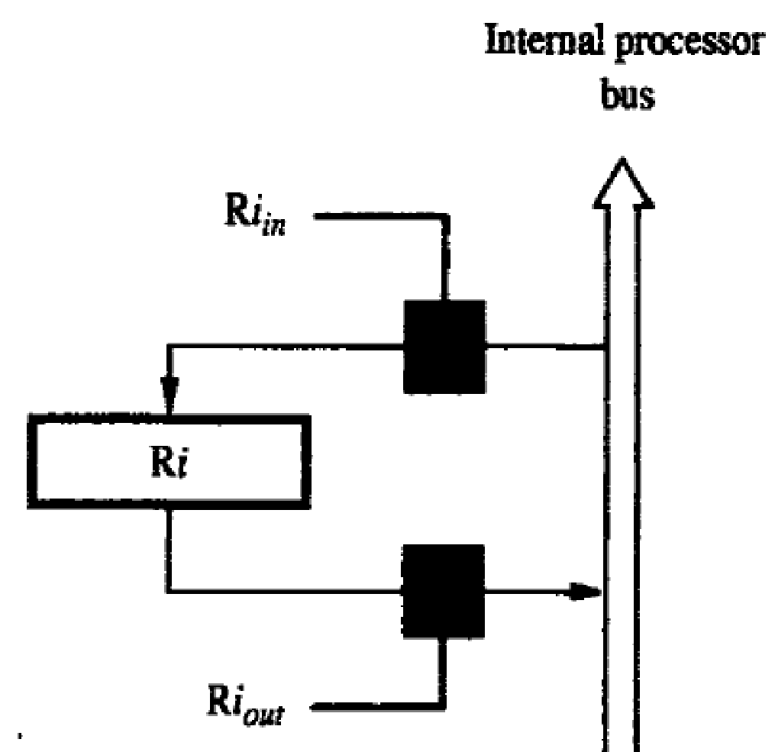
Register Transfers
Instruction execution involves a sequence of steps in which data are transferred from one register to another.
The input and output of register Ri are connected to the bus via switches controlled by the signals Ri_{in} and Ri _{out}, respectively.
When Ri _{in} is set to 1, the data on the bus are loaded into Ri. Similarly, when Ri _{out}, is set to 1, the contents of register Ri are placed on the bus.
While Ri _{out} is equal to 0, the bus can be used for transferring data from other registers.

Slide 45
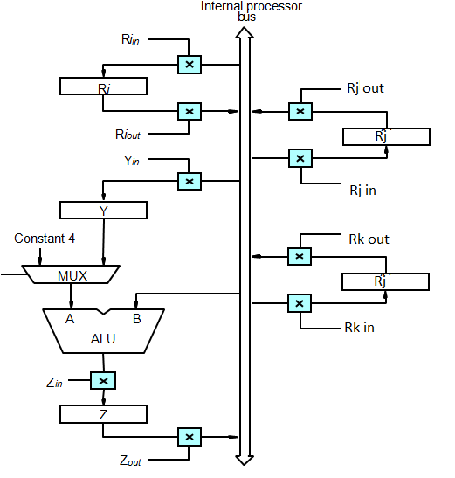
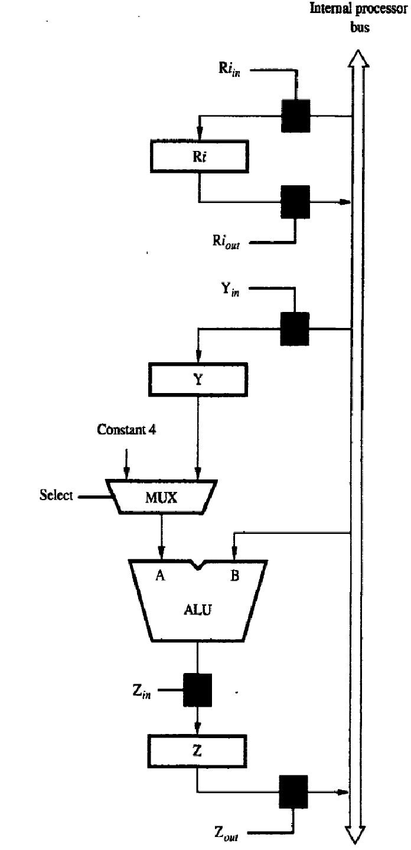
Performing an Arithmetic or Logic Operation
The ALU is a combinational circuit that has no internal storage.
It performs operation on the two operands applied to it on A and B i/ps.
ALU gets the two operands from o/p of the MUX and directly from the bus.
The result is temporarily stored in register Z
The sequence of operations for the instruction Add R1,R2,R3
1. R1_{out}, Y_{in}
2. R2_{out}, Select Y, Add, Z_{in}
3. Z_{out} R3_{in}

Slide 46
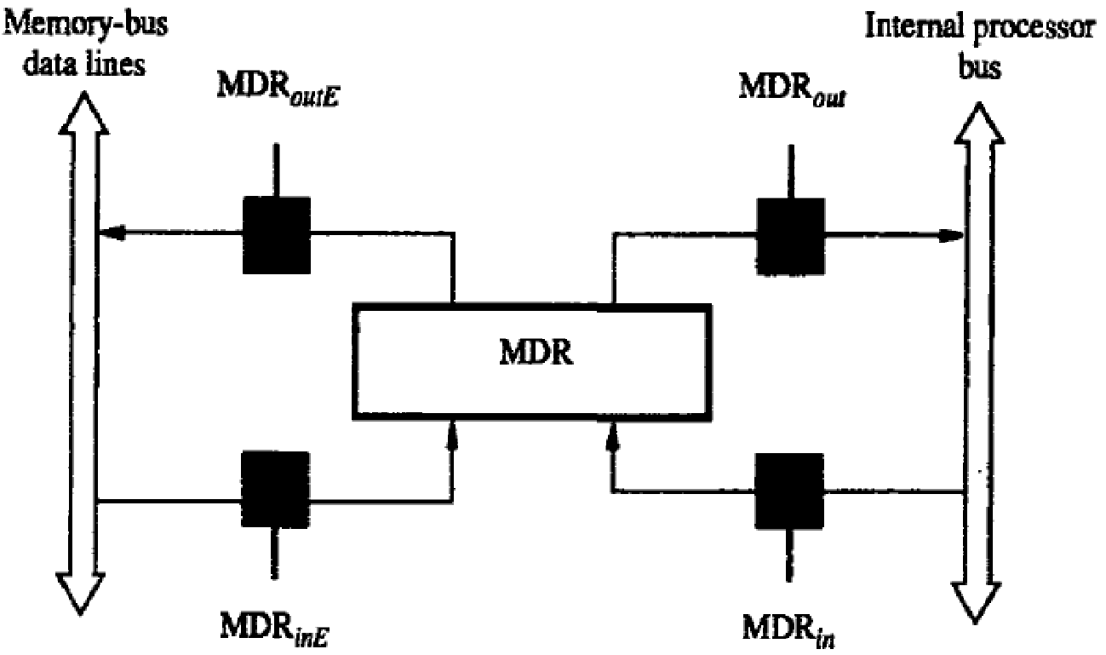
Fetching a Word from Memory
To fetch a word from memory, the processor has to specify the memory address and a read request is initiated
Address into MAR; issue Read operation; data into MDR.
MAR_{in} and MAR_{out} are the control connection to MAR register
MDR_{in} and MDR_{out} are control connections to internal bus and MDR_{inE} and MDR_{outE} are control connection to external bus

Slide 47
Fetching a Word from Memory
The response time of each memory access varies because of cache miss, memory-mapped I/O etc.
To accommodate this, the processor waits until it receives an indication that the requested operation has been completed (Memory-Function-Completed, MFC).
As an example of a read operation, consider the instruction Move (R1),R2. The actions needed to execute this instruction are:
1. MAR ← [RI]
2. Start a Read operation on the memory bus
3. Wait for the MFC(Memory Function Completed) response from the memory
4. Load MDR from the memory bus
5. R2 ← [MDR]

Slide 48
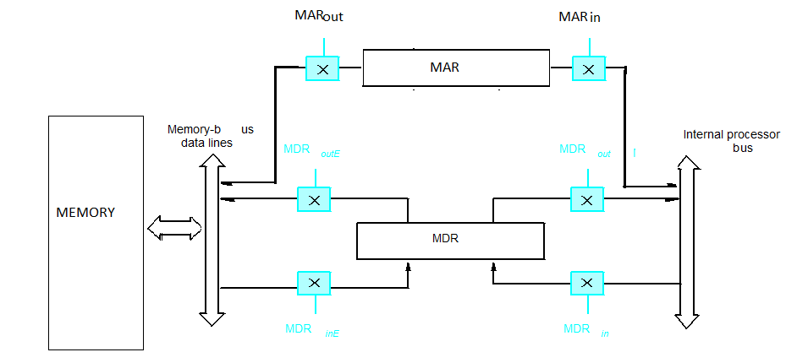
Fetching a Word from Memory
Move (R1),R2
The control sequence for the operation
R1_{out}, MAR_{in}, Read
MDR_{inE},WMFC
MDR_{out},R2_{in}

Slide 49
Storing a word in Memory
Writing a word into a memory location follows a similar procedure.
The desired address is loaded into MAR. Then, the data to be written are loaded into MDR, and a Write command is issued.
Hence, executing the instruction Move R2,(R1) requires the following sequence:
1. R1out, MARin
2. R2out, MDRin, Write
3. MDRoutE, WMFC

Slide 50
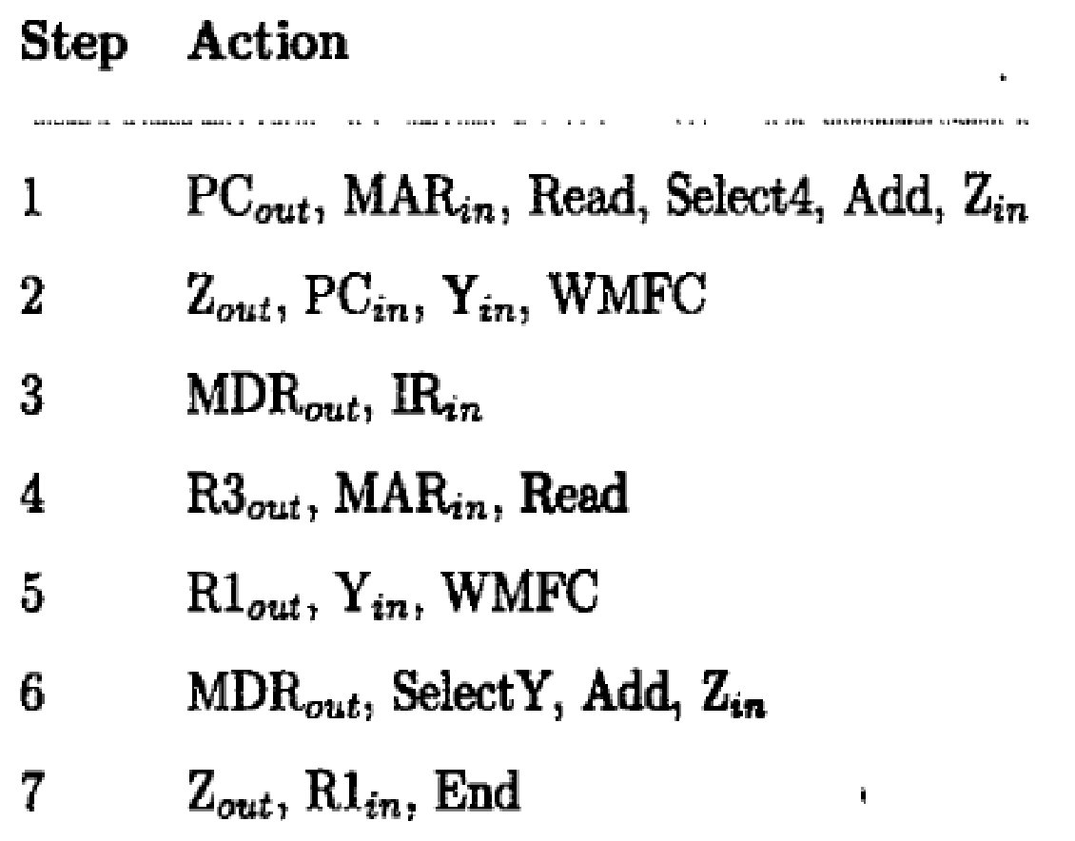
EXECUTION OF A COMPLETE INSTRUCTION
Consider the instruction Add (R3),R1 which adds the contents of a memory location pointed to by R3 to register R 1. Executing this instruction requires the following actions:
1. Fetch the instruction.
2. Fetch the first operand (the contents of the memory location pointed to by R3).
3. Perform the addition.
4. Load the result into RI.

Slide 51
Execution of a Complete Instruction
Add (R3), R1

Slide 52
Branch Instruction
A branch instruction replaces the contents of the PC with the branch target address.
This address is usually obtained by adding an offset X, which is given in the branch instruction, to the updated value of the PC. Figure gives a control sequence that implements an unconditional branch instruction.
Processing starts, as usual, with the fetch phase. This phase ends when the instruction is loaded into the IR in step 3.
The offset value is extracted from the IR by the instruction decoding circuit, which will also perform sign extension if required.
Since the value of the updated PC is already available in register Y, the offset X is gated onto the bus in step 4, and an addition operation is performed. The result, which is the branch target address, is loaded into the PC in step 5.

Slide 53
Execution of Branch Instructions
Step
Action
1
PC
out
,
MAR
in
,
Read,
Select4,
Add,
Z
in
2
Z
out
,
PC
in
,
Y
in
,
WMF
C
3
MDR
out
,
IR
in
4
Offset-field-of-IR
out
,
Add,
Z
in
5
Z
out
,
PC
in
,
End
Figure 7.7. Control sequence for an unconditional branch instruction.

Slide 54
Step
Action
1
PC
out
,
MAR
in
,
Read,
Select4,
Add,
Z
in
2
Z
out
,
PC
in
,
Y
in
,
WMF
C
3
MDR
out
,
IR
in
4
Offset-field-of-IR
out
,
Add,
Z
in
5
Z
out
,
PC
in
,
End

Slide 55
Step
Action
1
PC
out
,
MAR
in
,
Read,
Select4,
Add,
Z
in
2
Z
out
,
PC
in
,
Y
in
,
WMF
C
3
MDR
out
,
IR
in
4
Offset-field-of-IR
out
,
Add,
Z
in
5
Z
out
,
PC
in
,
End

Slide 56
Step
Action
1
PC
out
,
MAR
in
,
Read,
Select4,
Add,
Z
in
2
Z
out
,
PC
in
,
Y
in
,
WMF
C
3
MDR
out
,
IR
in
4
Offset-field-of-IR
out
,
Add,
Z
in
5
Z
out
,
PC
in
,
End

Slide 57
Step
Action
1
PC
out
,
MAR
in
,
Read,
Select4,
Add,
Z
in
2
Z
out
,
PC
in
,
Y
in
,
WMF
C
3
MDR
out
,
IR
in
4
Offset-field-of-IR
out
,
Add,
Z
in
5
Z
out
,
PC
in
,
End

Slide 58
Step
Action
1
PC
out
,
MAR
in
,
Read,
Select4,
Add,
Z
in
2
Z
out
,
PC
in
,
Y
in
,
WMF
C
3
MDR
out
,
IR
in
4
Offset-field-of-IR
out
,
Add,
Z
in
5
Z
out
,
PC
in
,
End

Slide 59
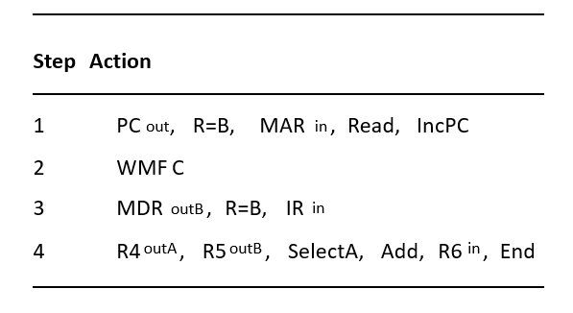
Multiple-Bus Organization
Add R4, R5, R6

Slide 60
Multiple-Bus Organization
Add R4, R5, R6

Slide 61
Multiple-Bus Organization
Add R4, R5, R6

Slide 62
Multiple-Bus Organization
R4
Add R4, R5, R6
R6
R5
Add

